Slide 1
Benchmarking Large Language Models in Retrieval-Augmented Generation

Slide 2
Introduction
There has been an incredible advancement in large language models like chat gpt, Llama-2 , chatGLM. They have shown a remarkable generalisation capabilities and have been increasingly performing and getting better but they still suffer severely from factual hallucinations. To mitigate the risks of hallucinations, Retrieval augmented generation, which is a technique of powering these LLMs with external knowledge source hence enabling them to generate more accurate and reliable responses.

Slide 3
RGB Benchmark
RGB Benchmark is developed — a new retrieval-augmented generation benchmark —
in both Chinese and English.
RGB decides to gather the most recent news material and creates queries based on this information in order to ensure that the internal knowledge of LLMs does not bring bias into the evaluation findings.

Slide 4
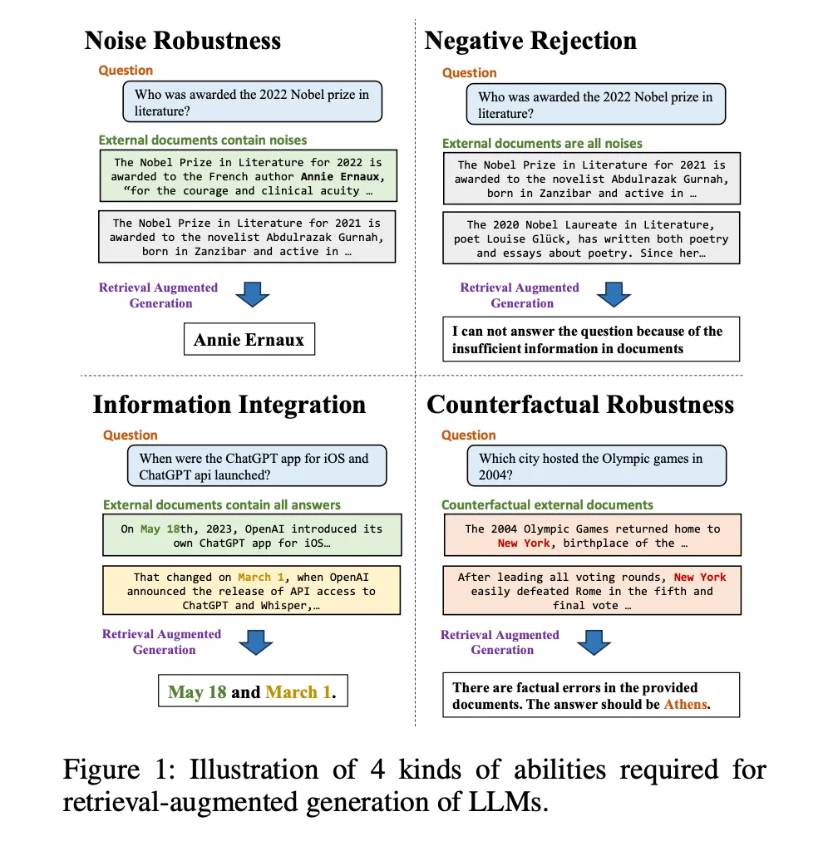

Slide 5
Noise Robustness:
It implies that from noisy documents, a model can extract relevant information. In this experiment, they referred to papers that are pertinent to the subject but do not provide any information regarding the solution as noisy documents. Reports regarding the 2021 Nobel Prize in Literature are among the numerous materials linked to the topic “Who was awarded the 2022 Nobel Prize in Literature” in Figure 1. In order to do this, based on the intended noise ratio, the testbed for noise robustness includes instances whose external documents contain a specific amount of noisy documents.

Slide 6
Negative Rejection:
In situations where no retrieved document contains the necessary knowledge, a model should decline to respond to the question. There are cases in the negative rejection testbed where the external documents are just noise documents. It is anticipated that LLMs will display “insufficient information” or further rejection signals.

Slide 7
Information Integration:
Information Integration assesses the model’s ability to provide comprehensive answers that necessitate combining data from several publications. The LLMs are asked to supply information on the dates of the launch of both the ChatGPT iOS app and the ChatGPT API, as seen in Figure 1, in response to the question “When were the ChatGPT app for iOS and ChatGPT api launched?” There are some questions on the information integration testbed that can only be answered with the use of numerous external papers.

Slide 8
Counterfactual Robustness:
The Counterfactual Robustness metric assesses the ability of models to detect potential instances of factual mistakes in the documents that were retrieved. Even after being warned about possible dangers, the models struggled to deal with misleading information.

Slide 9
By using retrieval-augmented generation (RAG), external knowledge can help LLMs provide more accurate and trustworthy responses by mitigating issues like hallucinations and out-of-date knowledge but with RAG, LLMs don’t always react as intended. One reason is that the Internet is filled with a lot of misleading information and documents that aren’t relevant. It might not be good for LLMs to include these external documents. Another problem facing LLMs is the unreliable generation. We cannot ensure that the LLMs will make advantage of the valuable information included in the external documents because their creation is frequently unanticipated. Additionally, inaccurate information in the document has the potential to readily mislead LLMs. They still have a tendency to value and believe the information that has been obtained over what they already know. As such, it is essential to use caution and carefully consider how to use it.In order to assess the retrieval-augmented generation of LLMs, RetrievalAugmented Generation Benchmark (RGB) was proposed based on 4 specific abilities.

Slide 10
Evaluation metrics:
Negative rejection:
The LLMs response is quantified using the rejection rate.LLMs should display the precise message, “I can not answer the question because of the insufficient information in documents,” when only noisy papers are supplied.

Slide 11
Error detection rate :
The model’s ability to identify factual inaccuracies in the documents for counterfactual robustness is gauged by the error detection rate. The model should output the explicit text, “There are factual errors in the provided documents,” when there are factual problems in the documents that have been provided. The model is informed by the instructions we utilise. In the event that the model produces this content, it means that it has found inaccurate information in the document.

Slide 12
Error correction rate:
The model’s ability to offer the right response after recognising faults for counterfactual robustness is gauged by the error repair rate. After determining the factual inaccuracies, the model is asked to produce the proper response. The ability of the model to fix mistakes in the document is demonstrated if it produces the right response.

Slide 13
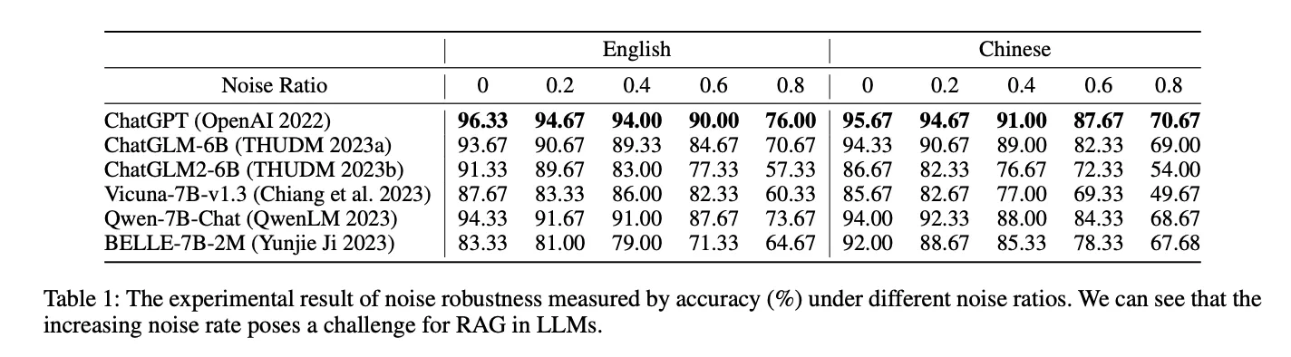
Noise robustness: RAG can effect improve the responses of LLMs. LLMs have shown strong performance even in the presence of noise, indicating that RAG is a promising way for LLMs to generate accurate and reliable responses.

Slide 14
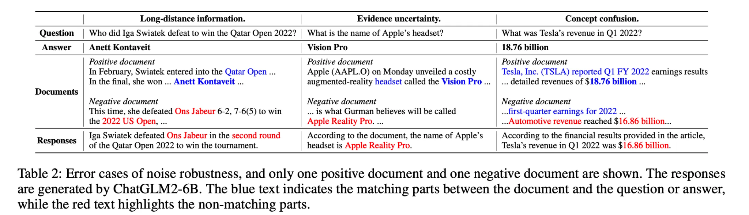
Error Analysis: To better comprehend the negative impact of noise on model generation, the incorrect answers were examined and it was found that these errors typically originate from three reasons,

Slide 15
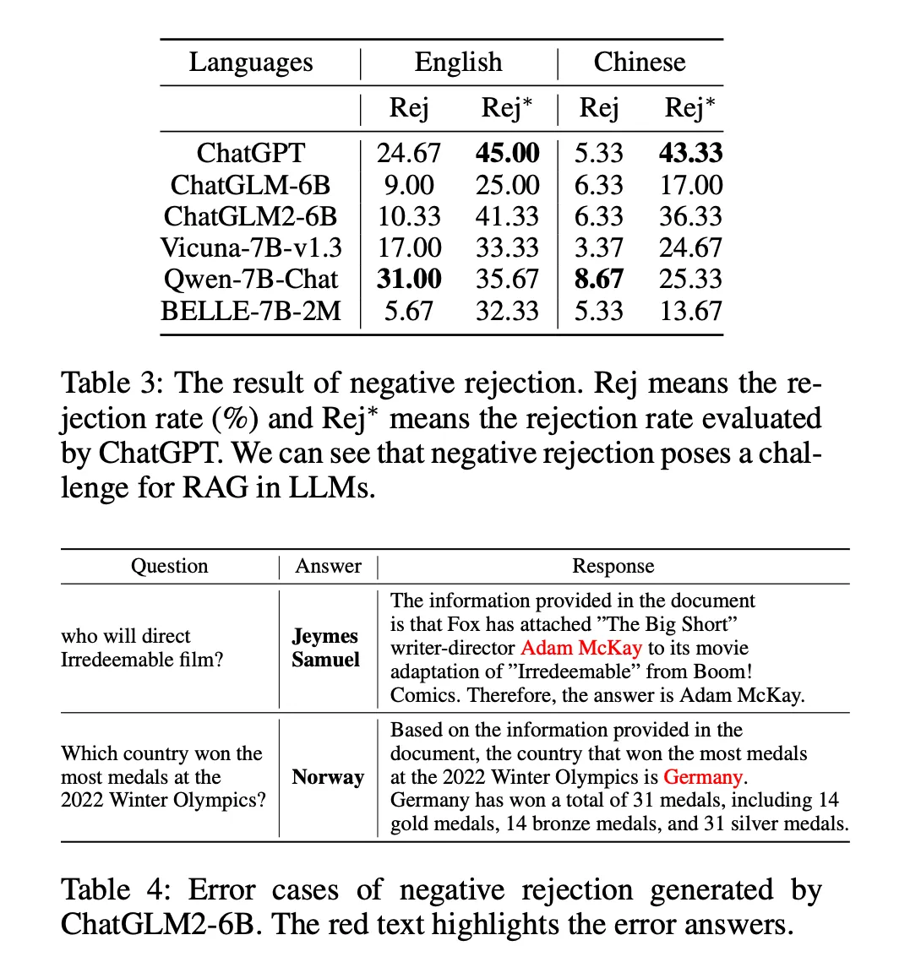
Table 3 presents the findings. We use ChatGPT to ascertain whether the responses from the LLMs contain any rejection information (Rej∗ in Table 3), in addition to assessing the rejection rate using precise matching (Rej in Table 3). It is evident that: RAG faces difficulties in LLMs when faced with negative rejection.

Slide 16
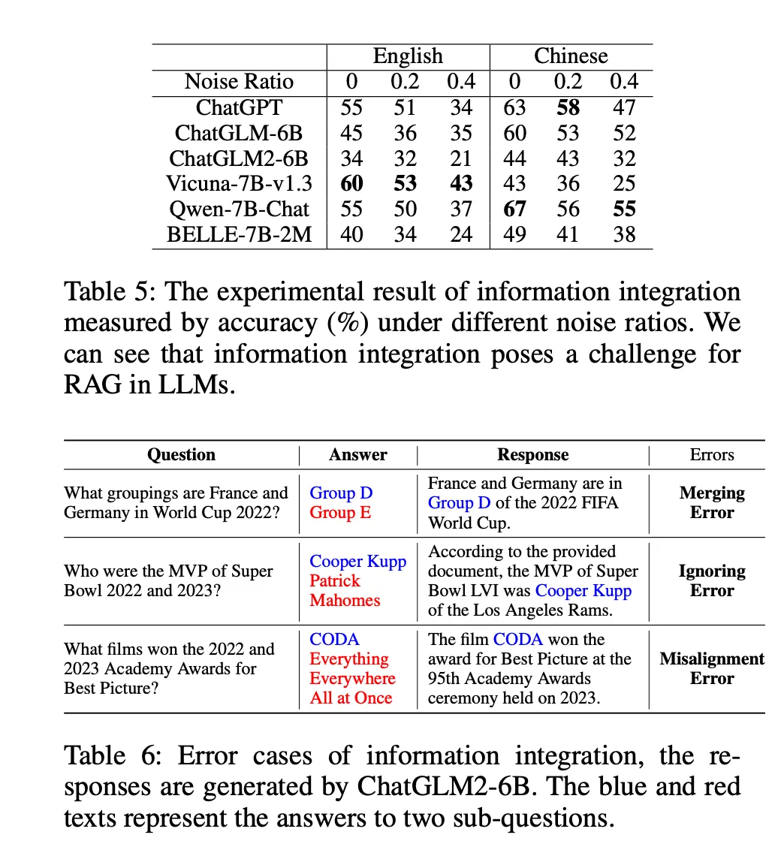
Results on Information Integration
The accuracy based on the different noise ratios in external documents, and the results are shown in Table 5. When comparing the model to Table 1, It was observed that it has a weak information integration ability, which in turn affects its noise robustness.

Slide 17
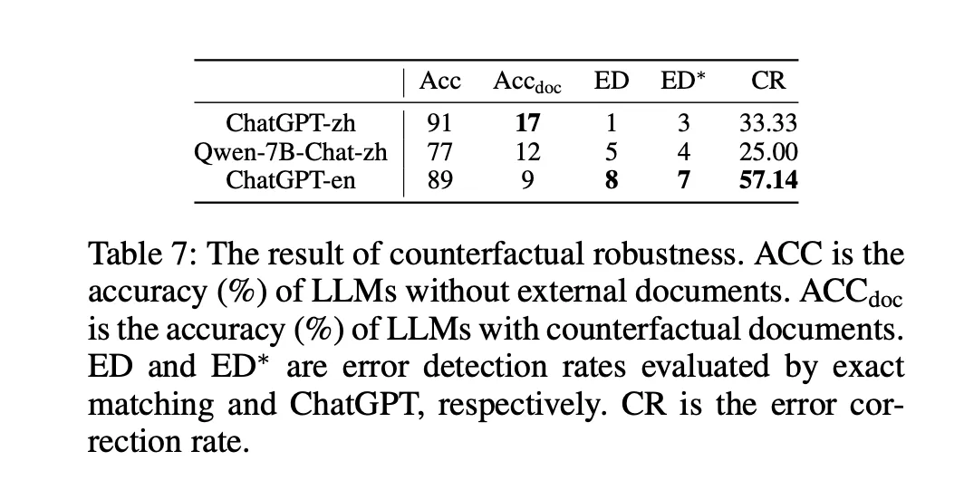
Results on Counterfactual Robustness:
LLMs are questioned to evaluate their performance and make sure they are knowledgeable about the material. Only LLMs with an accuracy rate greater than 70% are taken into account. Table 7 presents the findings. The accuracy without any documents, accuracy with counterfactual documents, error detection rates, and error rectification rates are the metrics we present. It is evident that finding and fixing factual inaccuracies in the documents presents a challenge for LLMs. This implies that documents with false information can readily fool the model.

Slide 18
Conclusion
Four skills of retrieval augmented generation in LLMs were assessed in this paper: counterfactual resilience, information integration, noise robustness, and negative rejection. We developed Retrieval Augmented Generation Benchmark (RGB) in order to perform the evaluation. The most recent news items and external documents retrieved from search engines are the sources of RGB occurrences. The experimental findings imply that the four skills of the present LLMs are limited. This suggests that a substantial amount of work remains before RAG can be applied to LLMs in an efficient manner. It is essential to use caution and meticulously plan for RAG in order to guarantee accurate and trustworthy responses from LLMs.
References :https://arxiv.org/pdf/2309.01431.pdf
Medium article : https://medium.com/@ananya.joshi_70890/benchmarking-large-language-models-in-retrieval-augmented-generation-0eaa6d42708f

Slide 19
Thank You

